Slide 1
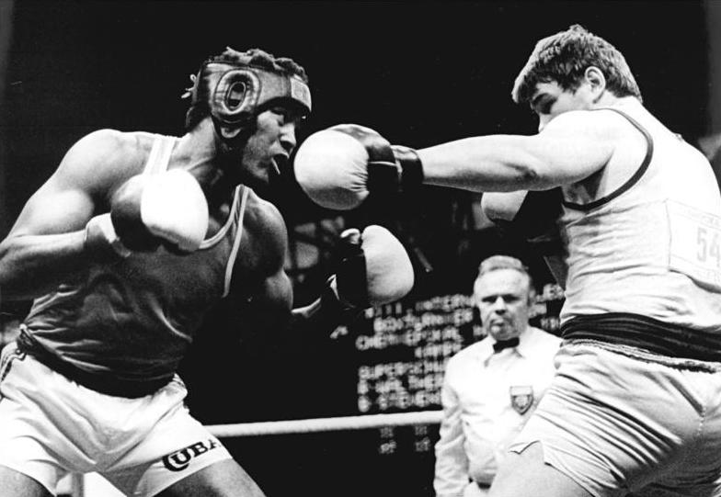
Teófilo Stevenson
Table 2:
Adam, Chad, Ess, Marilyn, Timothy

Slide 2
Teófilo Stevenson
Event | 1st | 2nd | 3rd
Olympic Games | 3 (72, 76, 80) | 0 | 0
World Championships | 3 (74, 78,86) | 0 | 0
Central American Championships | 6 (70, 71, 72, 73, 74, 77) | 0 | 0
North American Championships | 0 | 0 | 1 (83)
Pan American Games | 2 (75,79) | 0 | 1 (71)
Central American and Caribbean Games | 2 (74, 8) | 0 | 0
Friendship Games | 1 (84) | 0 | 0
Total | 17 | 0 | 2
Born: March 29, 1952
Died: June 11 , 2012 from a Heart Attack
Boxing Stance: Orthodox
1st Boxer to win 3 gold medal in the same division in the Olympics
90% win percentage
Total Fights | 332
Wins | 302
Losses | 22
Draws | 8

Slide 3

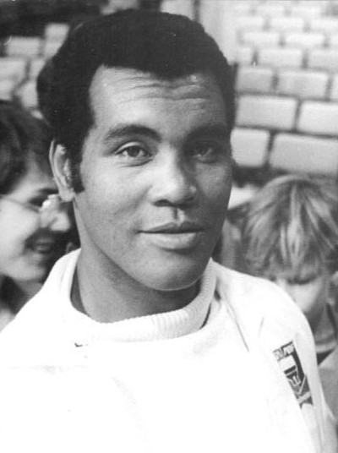



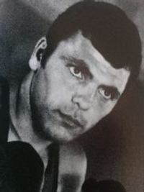
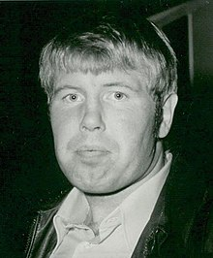
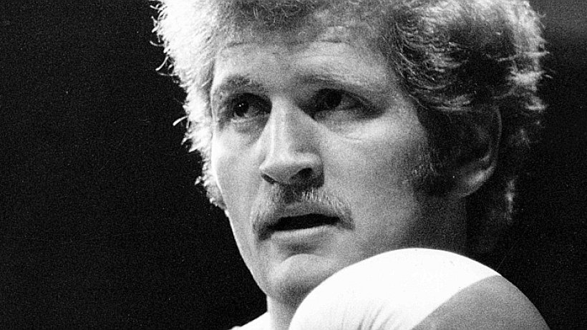
1972 Olympics Boxing Heavyweight
Teófilo Stevenson
Ion Alexe
Hasse Thomsen
Peter Hussing
1
2
3
3

Slide 4


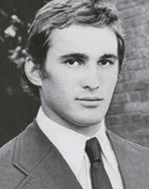
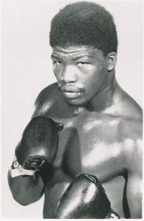
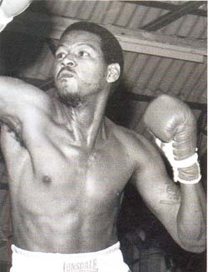
1976 Olympics Boxing Heavyweight
Teófilo Stevenson
Mircea Șimon
John Tate
Clarence Hill
1
2
3
3

Slide 5



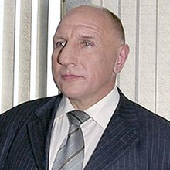

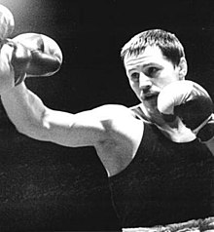
1980 Olympics Boxing Heavyweight
Teófilo Stevenson
Pyotr Zayev
István Lévai
Jürgen Fanghänel
1
2
3
3

Slide 6
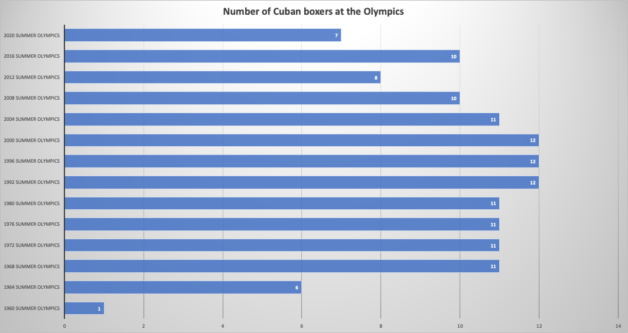
Cuba’s participation in Olympic Boxing events

Slide 7
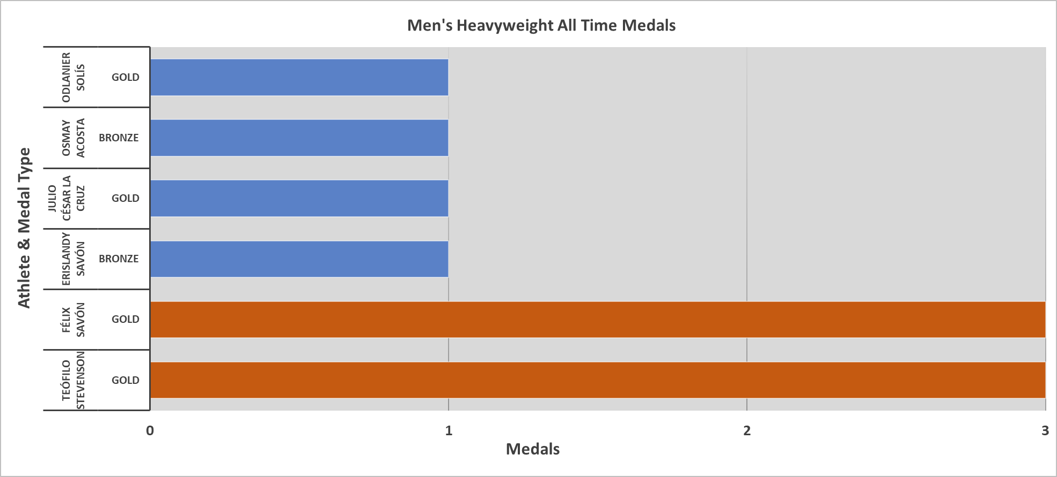
Was Teófilo Stevenson the top Boxer in Cuba?

Slide 8
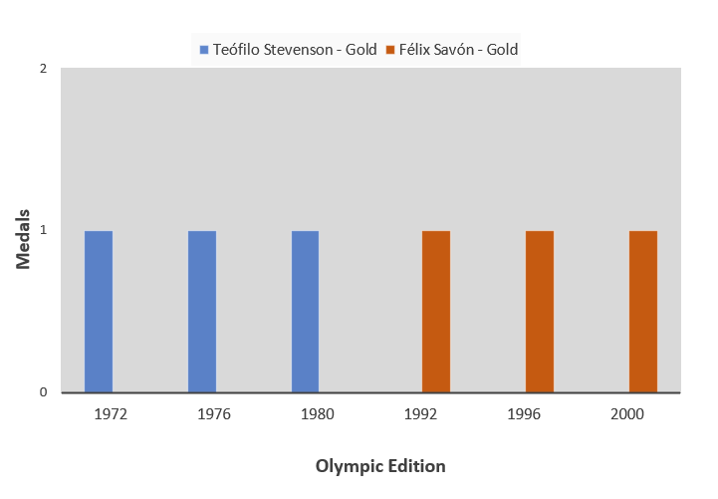
Was Teófilo Stevenson the top Boxer in Cuba?
Notes:
In his opening match in 1972 against Polish fighter Ludwik Denderys, Stevenson knocked Denderys down within 30 seconds of the opening bell.
In 1976, Stevenson disposed of his first three opponents in a record 7 minutes and 22 seconds.
Stevenson might have won a fourth gold medal at the 1984 Summer Olympics, but the Soviet Union boycotted the games, which were hosted by Los Angeles. Cuba followed the Soviet lead, and Stevenson did not compete. Stevenson retired in 1988 after Cuba decided to skip the Seoul Olympics.

Slide 9

Teófilo Stevenson Rivals
Notes:
Mircea Simon 191 cm

Slide 10
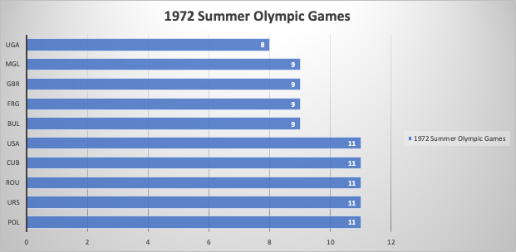
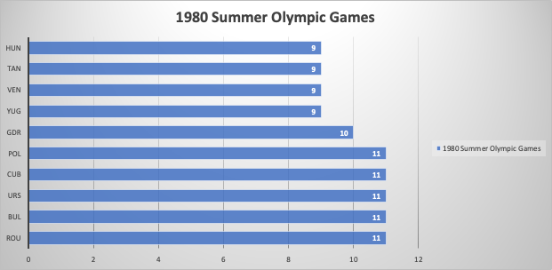
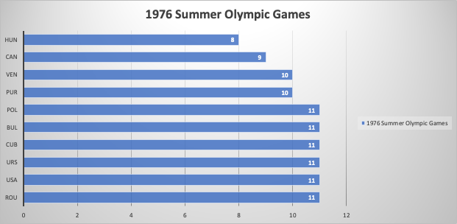
Number of Participants each country sent
Notes:
Animated slides, click to active the animation. There should be a total of 3 charts, 1972, 1976, 1980. Thanks!

Slide 11
